Slide 1
Information Extraction from Meeting Transcripts
Presenter: Ming Jeng – ML Intern from Emerging Tech Team
Mentors: Prateek Jain and Scott Tilney
Co-workers: William Ellsworth , Nima Chatlani, and Mariel Aquino
Manager: Gaurav Totla
Aug. 23, 2020
Notes:
INTRODUCE YOURSELF
Past two months been trying do some form of information extraction from meeting transcripts
It was fun and rewarding to work and Learn A lot from Prateek, Scott, and William, they gave a lot of good pointers n helped alot, (SMILE) same with Mariel and Neema.

Slide 2
Market Relevance
Problem Statements
Solution
Challenges
Demo
Backup (Optional)
Notes:
With 10 minutes.
I will emphasize a little on the relevance in the beginning, cause I think there's an unfulfilled need in high demand for this sort of products.
Brush over the high level challenges
Then finally demo.
and that's it, and u guys can ask questions.

Slide 3
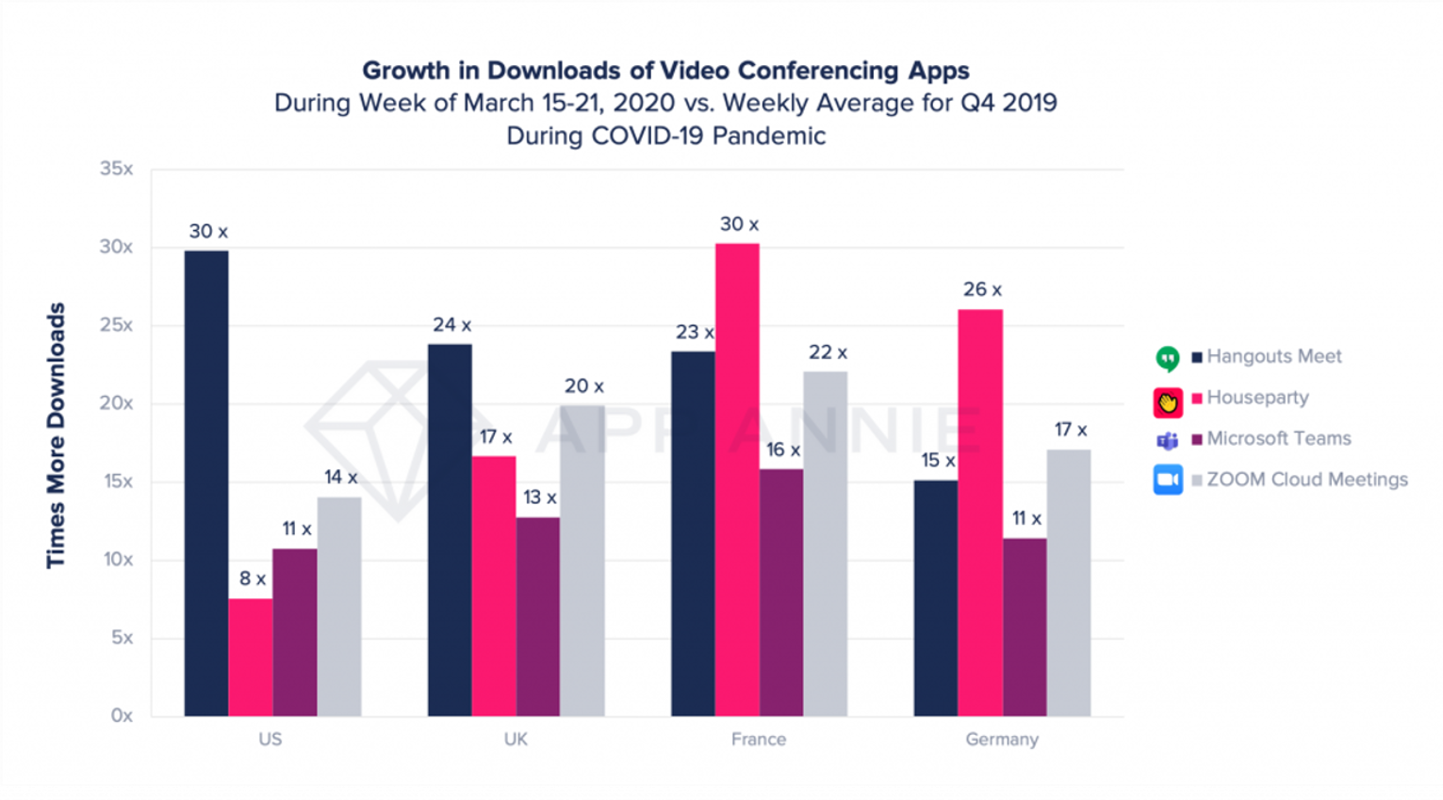
Data is from TechCrunch
Notes:
Like you all know since COVID, Vid Conferencing spiked up.
- Number of Zoom downloads went up 30x since covid compared to avg downloads before COVID
Other video communication tech has grown many folds as well as you can see here

Slide 4
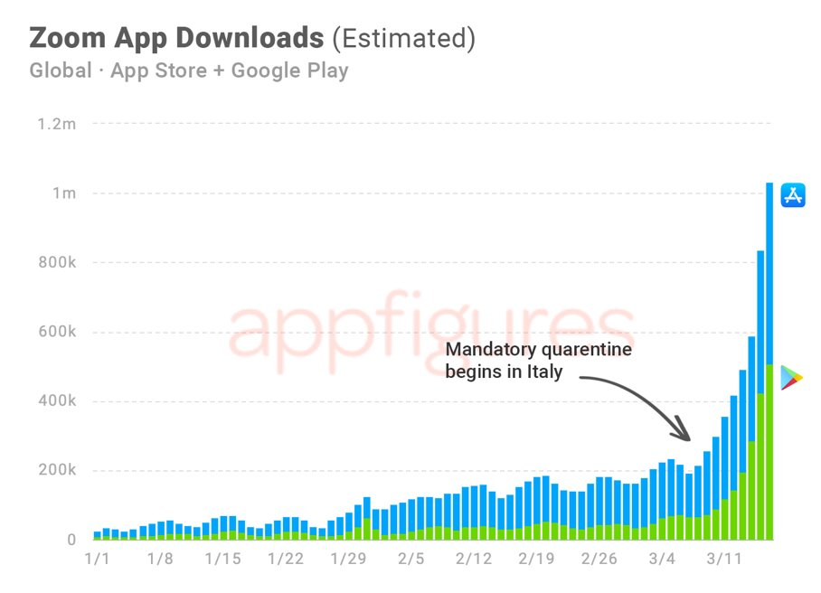
Perfect Timing
Data is from appfigures.com
Notes:
This really is a perfect timing any sort of tech built on video conferencing platforms.
This is an inflection point, and demand is greater than ever b4.

Slide 5
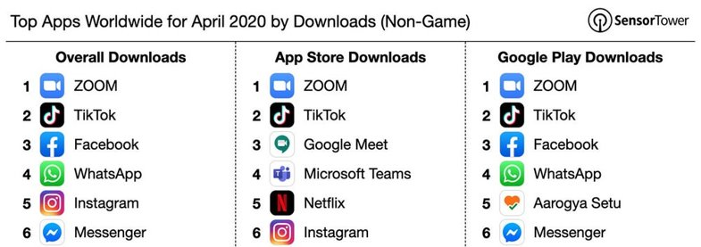
Perfect Timing
Data is from Entrepreneur.com
Notes:
Zoom is the most downloaded app in all app stores, so building a technology primarily around Zoom makes a lot of sense.

Slide 6
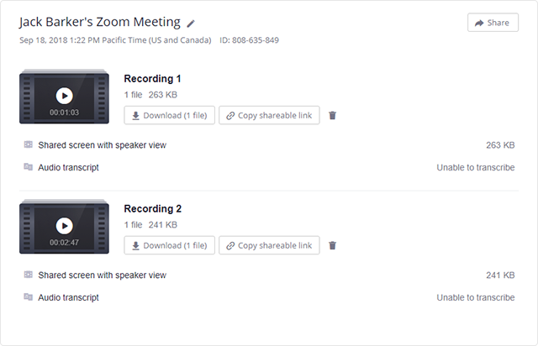
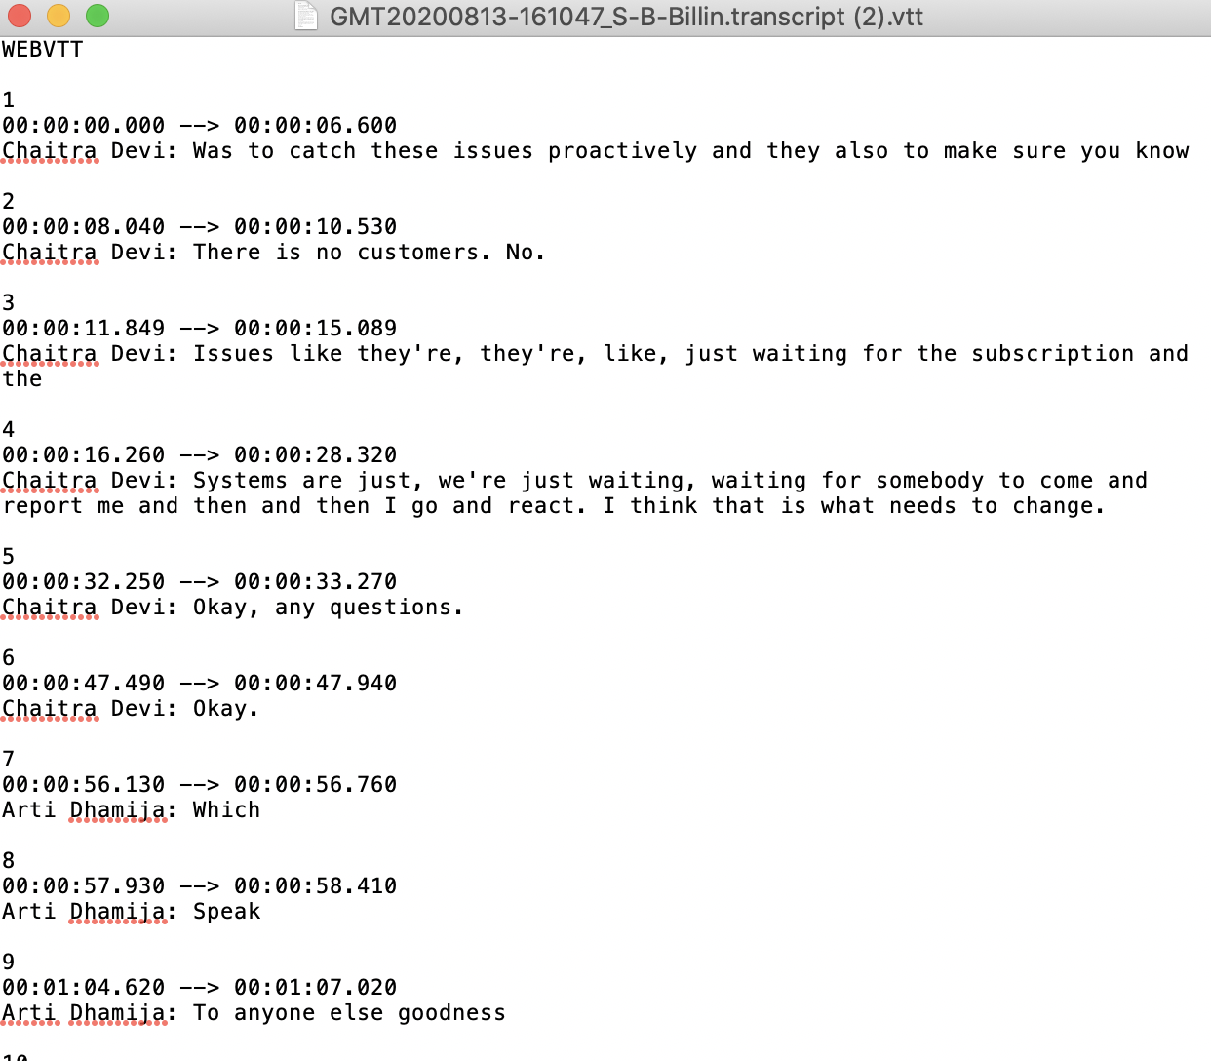

Transcription Service
Speech to Text (ASR)
Notes:
All video conferencing tech has a transcription service. This is zoom's platform. They convert speech to text through ASR, producing a text file as the transcript

Slide 7
Problem Statements
Writing Meeting Minutes is essential but can be very time consuming
Too many meetings to keep track of
Hard to recall highlights/action items
Don't want to replay entire recording
Miss Meetings
Busy Calendar
Too many meetings cause of COVID (meeting fatigue)
Out on PTO
Notes:
Most people have a lot zoom meetings everyday, resulting in a packed calendar.
- Miss meetings due to conflicts
Writing Meeting Minutes is excruciating but very important.
- Honestly, after a meeting, often times we tend to forget details, actionable items, especially if we have consecutive meetings.
- Replaying entire meeting recording is time consuming

Slide 8
Solution:
Give a bird's-eye view of what was discussed
Highlights/actionable items of a meeting
Structure of a meeting
…
For collaborators/participants to look back to
Assist the writing of Meeting Minutes
Notes:
The product is to provide some form of assistance to people that write meeting minutes, or simply they want to recall something or miss the meeting and deciding whether to rewatch the recording.
Through keywords/highlights extraction, hopefully it will trigger memories for people through priming.

Slide 9
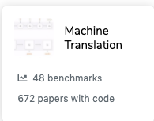
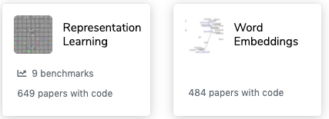
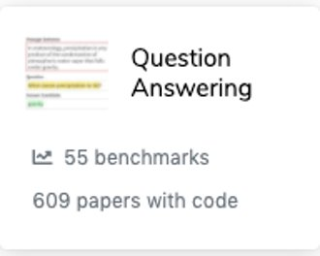
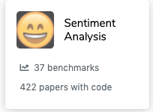
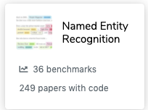
Challenges: Not plug and play
Above: Very well researched fields of NLP that have many Off the Shelf SOA models
Source: From paperswithcode.com (Website for ranking SoA models)
Notes:
Go over high lvl challenges.
There's many fields of NLP that's highly researched n considered "solved" with HUNDREDS of papers with code (cursor over) and you could just use it for your application.

Slide 10
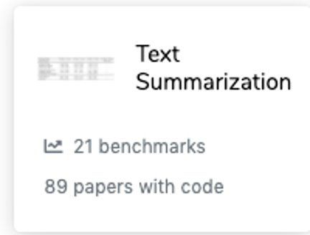
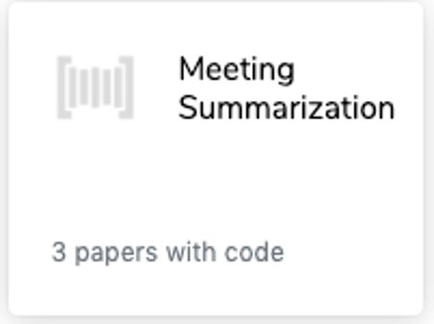
Challenges: Not plug and play
Source: From paperswithcode.com (Website for ranking SoA models)
Notes:
The task of extracting information, text summarization is definately a method. You put in text as input and it outputs a summary.
But actually, when we say "text" that means documents/articles but not "meeting transcripts", and these two kinds of data is very different.
Click Click Click
For the same task on different domain of data, the amount of open source research is v little. And those 3 papers with code don't work well

Slide 11
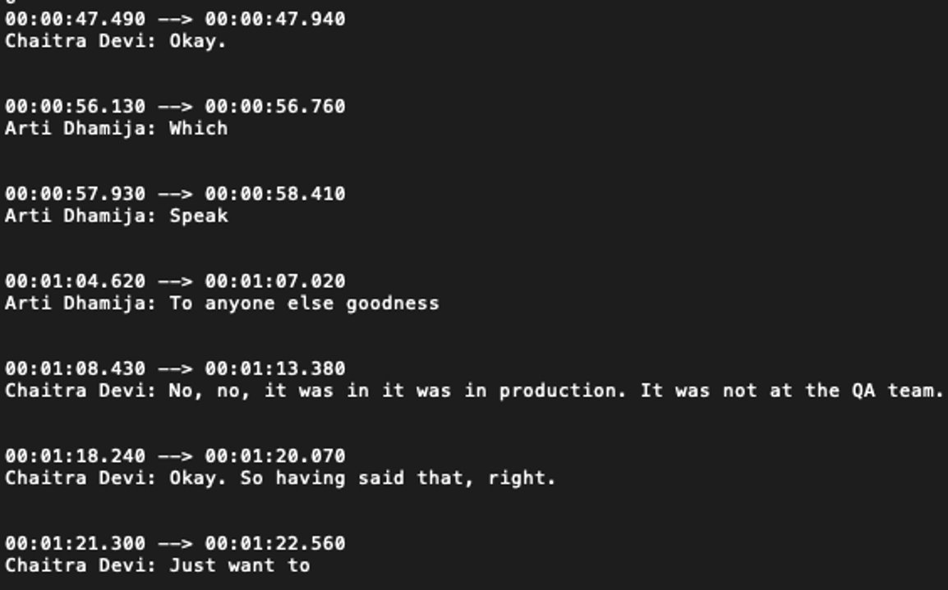
Challenges: Transcripts are very messy
Multiple Participants
There is no structure
Extremely low density of important content
ASR errors (punctuations, typos)
Notes:
Why is it so hard?
Just look at this screenshot of part of transcript.
Even as a human, when looking at transcripts, it very difficult to grasp important information. There's frequent
- Puncutation errors/Typos from ASR
- We interrupt each other v often
The way we talk, information is extremely sparse, so you can't just say, take the top 5 most important sentences and call it a summary.
other factors that throw ML models off
- rhetorical questions
- Sarcasm
- Small talk

Slide 12
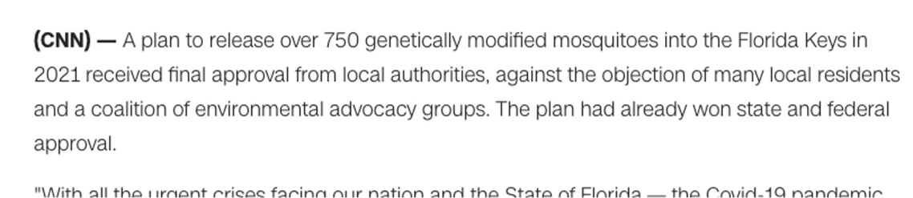
Regular text such as articles or documents are much more structured.
Source: From CNN article
Notes:
While for documents/regular text.
Read the first sentence and you immediately know what's going on.
Important information is very dense, every sentence conveys a lot of info. OFC there's no typos, punctuation problems, and it's single author with consistent style.
There's a study that says if you take first 3 sentences of a news article as a summary it often times outperforms Fancy DL models

Slide 13
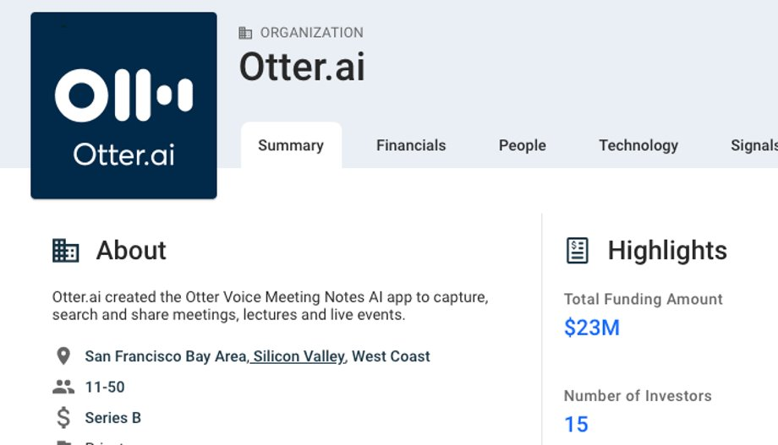
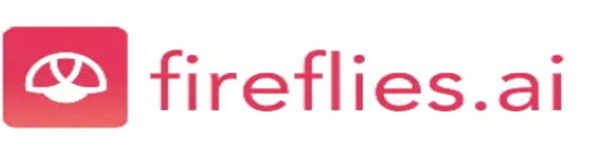

Current Market Solutions
Notes:
Because it's so hard and such an emergent field.
If you google "meeting summary ai notes" you will just bunch of startups like here. there's no dominating product from big tech Microsoft/Google yet.
Otter AI actually is the transcription service of Zoom and they are tackling Meeting Notes AI task as well.
I have used fireflies product, it’s AI has a lot of errors, and I have a slide for that if we have time.

Slide 14
DEMO
Notes:
Now for the Demo

Slide 15
Thanks to everyone who made this possible:
Thanks to Scott and Prateek for all the mentorship, guidance, and for organizing all of this
Thanks to William, Mariel, and Nima for all the advices and brainstorming

Slide 16
Backup and Supplementary

Slide 17
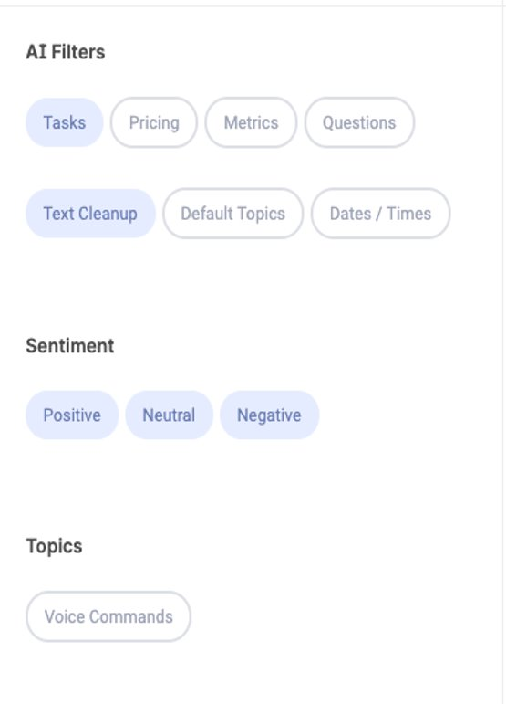
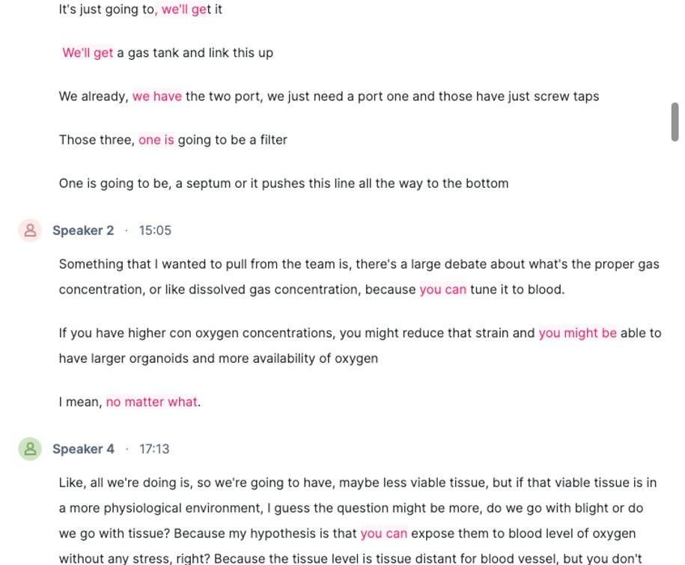
An example of many errors from a market solution
See interactive: https://app.fireflies.ai/view/Braingeneers-Life-Support-Weekly-meeting::7B3HYfIROz

Slide 18
Other Interests in Industry
https://techcrunch.com/2014/03/14/gridspace/
Zoom + Otter.AI
https://www.forbes.com/sites/jeanbaptiste/2019/06/19/ceo-tech-talk-how-otter-ai-uses-artificial-intelligence-to-automatically-transcribe-speech-to-text/#6321d4ed3872
Microsoft Research: https://www.microsoft.com/en-us/research/project/meeting-recognition-and-understanding/

Slide 19
Extractive summary vs Abstraction-based Summary
Source text: Joseph and Mary rode on a donkey to attend the annual event in Jerusalem. In the city, Mary gave birth to a child named Jesus.
Extractive summary: Joseph and Mary attend event Jerusalem. Mary birth Jesus.
Abstractive summary: Joseph and Mary came to Jerusalem where Jesus was born.

